Slide 2
It Begins with God (H)
It begins with the heart that brightly shines -- this is the love that God has for us

Slide 3
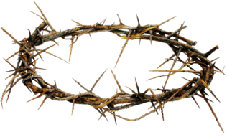
It is Because of What He Has Done. We Are Now Forgiven and Accepted. (H)
The cross and thorns -- Because He loves us, he takes on the crown of thorns and hangs on the cross for our shame, our sins, and our infirmities
The cross illuminates -- this is the power of the cross -- it has now brought us salvation and freedom -- a pathway to God

Slide 4
His Love Toward Us Sends Us Out (R M)
The heart says "to one another" and the arrows go out -- because of God’s wonderful gift of love, we ought to now be "to one another" instead of being inwardly seeking our selfish pursuits.
To One
Another

Slide 5
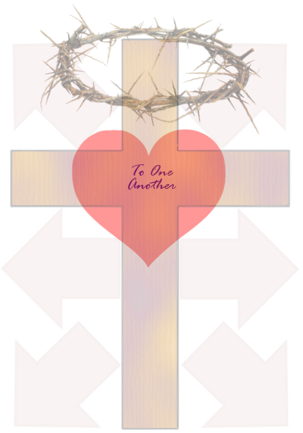
We Represent Jesus Through Our Lifestyles (J)
The picture is dimmed -- this is because He took the role of a lowly servant, and He desires us to do the same. We ought to be humble, serving, and loving, just as He is.
We win people over to Christ by His love toward us.

Slide 6
So, this is what we believe: It all starts from God and His love for us.
We can now have a loving relationship with God because of what Jesus has done.
Because we are loved, we love God back, particularly by demonstrating love toward others

Slide 7
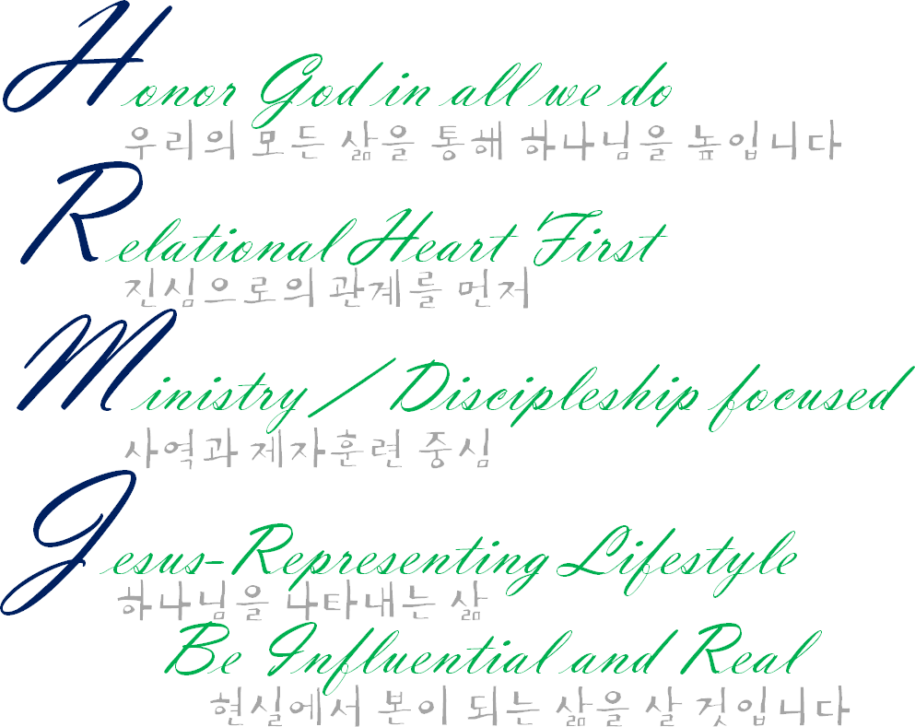
Our Values (가치) This is how we will live (이렇게 살겠습니다)
As a result of our gratefulness for what Jesus has done, we’ll seek to be worthy to be called His children by living as follows:
예수님이 하신 일로 인하여, 우리는 하나님의 자녀로 불리워 지며 자녀 된 권세를 누리며 살 것 입니다.

Slide 8
Be at constant communion with Him (Pray) 언제나 하나님과 함께 동행 (기도) 합니다.
Be at position of listening – Listen for His voice; Read, study, and meditate on Scriptures 귀를 귀우린다 – 하나님의 음성을 듣고, 성경을 읽고,공부하며, 묵상 합니다.
Live for Him – Make God the highest priority in life 하나님을 위하여 산다 – 무엇보다도 하나님을 삶의 우선순위로 합니다

Slide 9
To place God utmost in all our dealings, then placing others next. 하나님과의 관계를 언제나 우선순위로 합니다. 그 후로는 (자신이 아니라) 다른 사람들입니다.
To place our relationships with others first before technical perfection. 완벽함 보다 다른 사람들과의 관계를 우선순위로 합니다.
Be to One Another - Seek the good of others before self, be gracious in all our dealings (as we have received His grace), let others know about God, gather often, connect with others by accepting one another and striving to understand the other person’s position. 서로에게 (선을) 행한다 –나 자신의 의를 내세우는 것이 아니라, 하나님이 우리에게 주신 은혜 같이 서로에게 은혜로움을 나타내며 전합니다, 하나님을 전하며, 모이기에 힘쓰고, 서로를 받아주며 그 사람의 입장에서 생각합니다.
Doing our utmost to encourage and empower others to do ministries God has enabled them to 서로에게 하나님이 주신 사역들을 잘 감당 할 수 있도록 아낌없는 격려와 힘을 주세요.
Be One with Other Communities of God - partner with other local communities (churches) of God in reaching out to others 하나님을 믿는 여러 지역의 공동체와 하나가 되어 믿지 않은 자들에게 더 큰 사랑을 전달하고 본이 됨을 보여 줍니다.

Slide 10
Using God given talents, abilities, we will minister and disciple others to draw closer to God 하나님이 각자에게 주신 달란트 와 재능을 사용하여, 우리는 헌신하고 훈련하며 하나님과 가까워 질 수 있도록 이끌 것 입니다.
Team work, encourage, empower one another 함께 일하고, 격려하며, 서로에게 힘을 줄 것 입니다.
Be teachable 배울 자세를 갖겠습니다

Slide 11
To be unashamed to insert Jesus into everything we do. Online, at work, at school, with family, with friends, with anyone we may meet. 하나님이 우리 안에 계신 것을 부끄러워하지 맙시다. 가족, 친구 그리고 우리가 만나는 모든 사람들, 더 나아가서 인터넷, 직장에서 또 한 하나님의 사랑을 드러내며 복음을 전파하고 전도하는 삶을 살 것 입니다.
Aim for excellence in all we do. Be respectable, be trustworthy, be exemplary disciple of Jesus so that we may win people over to Christ 우리가 하는 모든 일에 최선을 다할 것 입니다. 존경과 신뢰를 받을 만한, 예수님의 제자의 본이 되는 삶을 살겠습니다. 그 삶을 통해서 사람들의 마음을 예수님께로 이끌 것 입니다.
Be who you are without duplicity 정직하고 기만적이지 않는 삶을 살 것 입니다.

Slide 12
There is a reason why our logo is on all our work.
It’s so that whereever we are, whatever we are doing, we will remember what He has done (past), and continue to be led by what He is doing in our hearts now (present), and wait forward for His coming (future).

Slide 13
How Our Name Came To Be
God, how shall we live?
하나님, 우리가 어떻게 살아야 됩니까?

Slide 14
Who Belongs to “To One Another” Ministries?
We are “Young Adult” Ministries
College, Graduates, Young Working People (Ages 18-39)
Married and Unmarried people
Unbelievers, Believers with questions, Believers that desire to help unbelievers to come to know God
English, Korean, Spanish – Ratio of language use (80/20/0)
We Welcome
Honesty, sharing of our lives
Questions about life & Bible and discussions (web/box)
Prayer for One another
청년부라고 하지 맙시다
- 미혼자, 어린사람들 (ages 18-25)로 이해하게 됩니다

Slide 15
Through our gatherings, let us:
1. Worship (Transcendence, come meet the God who is beyond grasp and understanding – much more powerful, all able, omnipresent, can meet our needs)
2. Pray (Language of Intimacy, find significance of our lives by personally communing with our God)
3. Come Together (Form a community because of God's love for us).
Afterwards, let us live our lives outside of our gatherings
I am because we are
우리이기 때문에 내가 존재 한다 yo soy porque nosotros somos

Slide 16
Any Questions?

Slide 17
Communion - It’s about what Jesus has done, that brought us forgiveness and belonging
We are now one in Christ,
because of God’s love for us

Slide 18
Announcements
LiNK – Liberation for North Korea this Thursday.
DO NOT MISS IT!
No other activities planned at the moment. Anything we should do?

Slide 19
Now, this is your ministry –
How shall we develop it?
Is what we are doing good? Beneficial to you? What can we do to meet the needs of our peers?
How often shall we meet?
When we meet, what are you looking for?

Slide 20
It’s about what Jesus has done, that brought us forgiveness and belonging
We are now one in Christ,
because of God’s love for us

